Slide 1



DEPARTMENT OF COMPUTER SCIENCE & ENGINEERING
Domain Winter Winning Camp 2023
Subject Name: DBMS
Day: 8
Topic Covered: Difference between SQL and NOSQL.
SQL Profiler
Storing JSON file in Database
DISCOVER . LEARN . EMPOWER

Slide 2
These points related to Day wise topic should be included:
Prerequisite of topic: Basic knowledge of SQL
Objective: Knowledge of NOSQL, Working of SQL Profiler and import JSON file into database (MongoDB)
Outcome : Implement NOSQL queries , explanation of SQL Profiler

Slide 3
Topics Covered
Difference between SQL and NO SQL.
Why sql is called structured query language?
What is sql profiler?
How will you store Json file in database?

Slide 4
Difference between SQL & NOSQL
Parameter | SQL | NOSQL
Definition | SQL databases are primarily called RDBMS or Relational Databases | NoSQL databases are primarily called as Non-relational or distributed database
Design for | Traditional RDBMS uses SQL syntax and queries to analyze and get the data for further insights. They are used for OLAP systems. | NoSQL database system consists of various kind of database technologies. These databases were developed in response to the demands presented for the development of the modern application.
Query Language | Structured query language (SQL) | No declarative query language
Type | SQL databases are table based databases | NoSQL databases can be document based, key-value pairs, graph databases
Schema | SQL databases have a predefined schema | NoSQL databases use dynamic schema for unstructured data.

Slide 5
Cont…
Development Year | It was developed in the 1970s to deal with issues with flat file storage | Developed in the late 2000s to overcome issues and limitations of SQL databases.
Open-source | A mix of open-source like Postgres & MySQL, and commercial like Oracle Database. | Open-source
Consistency | It should be configured for strong consistency. | It depends on DBMS as some offers strong consistency like MongoDB, whereas others offer only offers eventual consistency.
Best Used for | RDBMS database is the right option for solving ACID problems. | NoSQL is a best used for solving data availability problems

Slide 6
Cont..
Hardware | Specialized DB hardware (Oracle Exadata, etc.) | Commodity hardware
Network | Highly available network (Infiniband, Fabric Path, etc.) | Commodity network (Ethernet, etc.)
Storage Type | Highly Available Storage (SAN, RAID, etc.) | Commodity drives storage (standard HDDs, JBOD)
Best features | Cross-platform support, Secure and free | Easy to use, High performance, and Flexible tool.
Examples | Oracle, Postgres, and MS-SQL. | MongoDB, Redis, Neo4j, Cassandra, Hbase.

Slide 7
Why SQL is called structured query language
Structured Query Language (SQL) is a programming language designed to get information out of and put it into a relational database.
SQL is the easiest language used to communicate with the RDBMS
Analyzing behavioral related and customized sessions
Building custom dashboards
It allows you to store and gets data from the database quickly
Preferred when you want to use joins and execute complex queries

Slide 8
SQL Profiler
An SQL server profiler is a tool for tracing, recreating, and troubleshooting problems in MS SQL Server, Microsoft’s Relational Database Management System (RDBMS).
It is used to trace activities and operations executed on a specific SQL Server database engine or Analysis Service to be analyzed later.
It’s like a dashboard that shows the health of an instance of MS SQL Server.
This function entirely happens on the client-side, which means it uses resources on the same machine that it is monitoring.

Slide 9
How does Profiler work in SQL Server
Profiler is a standalone software tool that is installed on the system with SQL Server installation setup.
We can use the Windows Explorer or SQL Server Management Studio to access the profiler.
To start the tool:
From the Start menu, Click on All Programs.
Go to Microsoft SQL Server 2018.
Go to Performance Tools.
Click on SQL Server Profiler

Slide 10
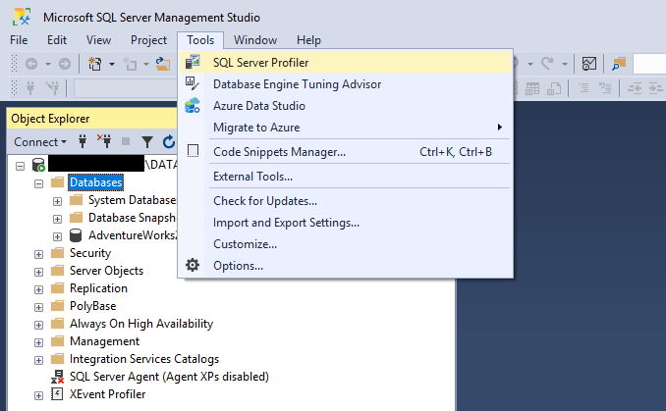
SQL Server Profiler from Management Studio
The profiler option as shown in the image below:

Slide 11
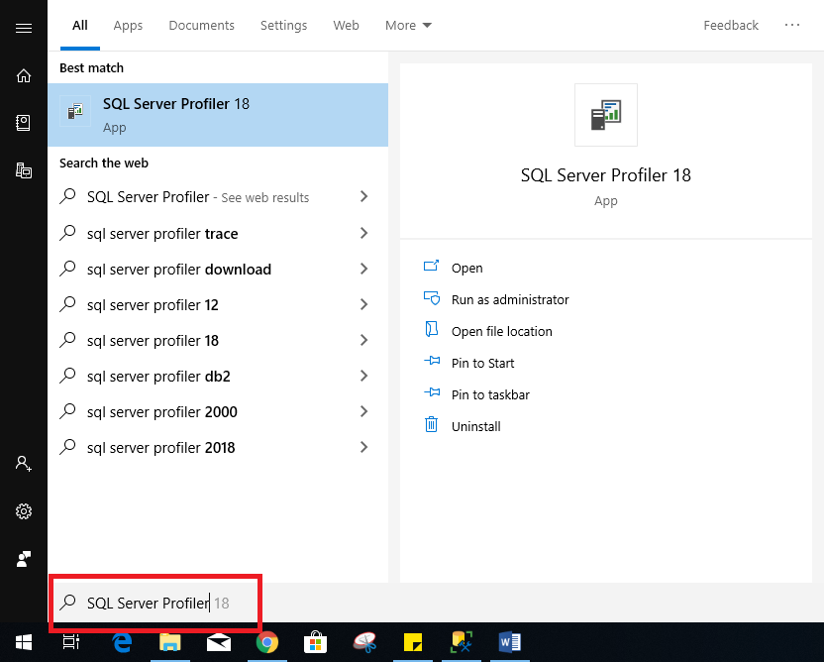
Another way to Open SQL Server Profiler
In Windows 10, then type SQL Server Profiler into the Start menu. We will see the application in the results as shown below:

Slide 12
Advantages of PROFILER
Clarity: It shows how an instance interacts with a client.
Troubleshoot Issues: It allows us to save and replay key events, which can help us in identifying trouble areas. It is also useful for stress testing and finding queries that take a long time to execute.
Allow non-administrator to create traces securely.
It also saves traces for SQL, SSIS, and Analysis Services.
Compare activity to baselines: It allows users to save trace data and compare it to fresh data in order to identify new problems.

Slide 13
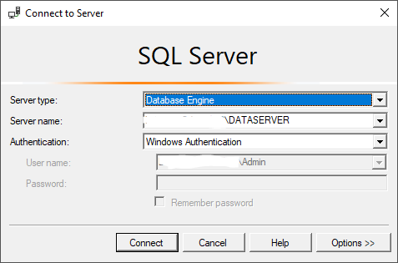
Profiler Authentication Form
When we open the profiler, it will ask for authentication.
Here we need to fill in the detail like server type (whether you want to connect to Analysis Service Instance or Database Engine), server name, authentication type, and credentials as shown in the below image:

Slide 14
Cont..
When we click on the connect button, the connection is established, and a new trace form appears on the screen.
There are two tabs named General tab and Events Selection :
General Tab: It is used for setting the trace database engine
Event Selection: The event is an action or operation performed on the database engine. An event tab is used for adding or removing the selected event for monitoring. The profiler tool can trace all events, and each event is categorized on a specific event class.

Slide 15
How to create a trace steps
On the File menu, click New Trace, and connect to an instance of SQL Server.
Then Trace Properties dialog box appears.
NOTE:
The Trace Properties dialog box fails to appear, and the trace begins instead, if Start tracing immediately after making connection is selected. To turn off this setting, on the *Tools *menu, click Options, and clear the Start tracing immediately after making connection check box.

Slide 16
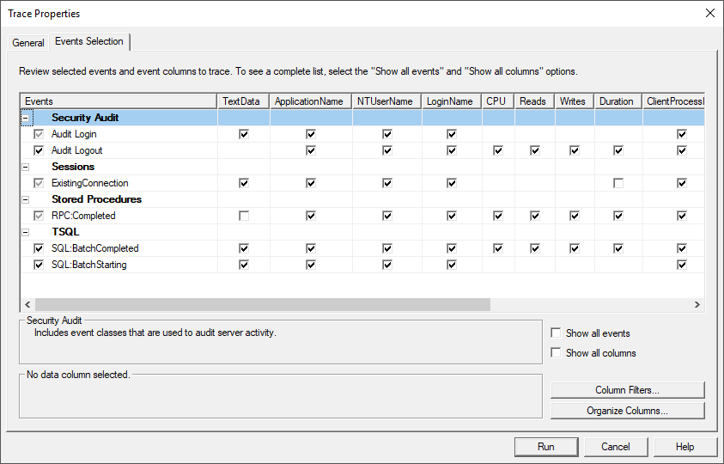
Trace Properties Dialog Box

Slide 17
Steps Cont..
In the Trace name box, type a name for the trace.
In the Use the template list, select a trace template on which to base the trace, or select Blank if you do not want to use a template.
To save the trace results, do one of the following:
Click Save to file to capture the trace to a file. Specify a value for Set maximum file size. The default value is 5 megabytes (MB).
Optionally, select Enable file rollover to automatically create new files when the maximum file size is reached.
You can also optionally select Server processes trace data, which causes the service that is running the trace to process trace data instead of the client application.
Click Save to table to capture the trace to a database table.

Slide 18
Steps Cont..
When you do not save the trace results to a file or table thus you lose the trace results after you stop the trace and close SQL Server Profiler.
To avoid losing the trace results in this way, click Save on the File menu to save the results before you close SQL Server Profiler.
Optionally, select the Enable trace stop time check box, and specify a stop date and time.
To add or remove events, data columns or filters, click the Events Selection tab
Click Run to start the trace.

Slide 19
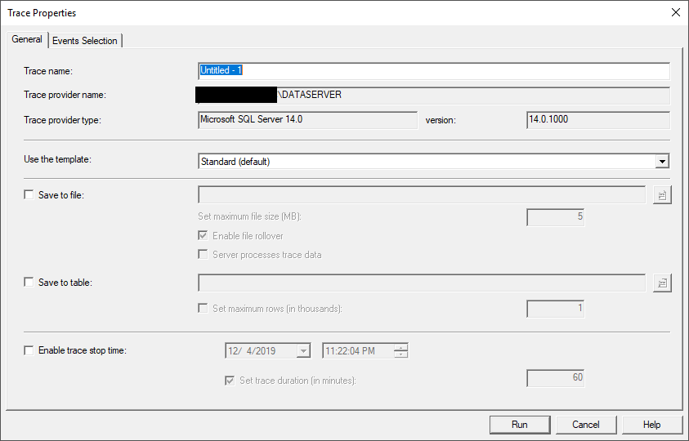
General Tab of the Trace Properties Form

Slide 20
JSON Introduction
JSON stands for JavaScript Object Notation
A JSON file has .json as its extension and the data inside are represented in a key:value pair, just like a traditional JavaScript object.
JSON is a lightweight format for storing and transporting data
JSON is often used when data is sent from a server to a web page
JSON is "self-describing" and easy to understand

Slide 21
How Json file import in MongoDB
In MongoDB, you can import the JSON file with the help of the mongoimport command.
Syntax:
mongoimport -jsonArray -db database_name -collection collection_name -file file_location
Here, mongoimport helps you to import JSON files, after that write the database name, collection name, and file location(path) that you want to import into your database.

Slide 22
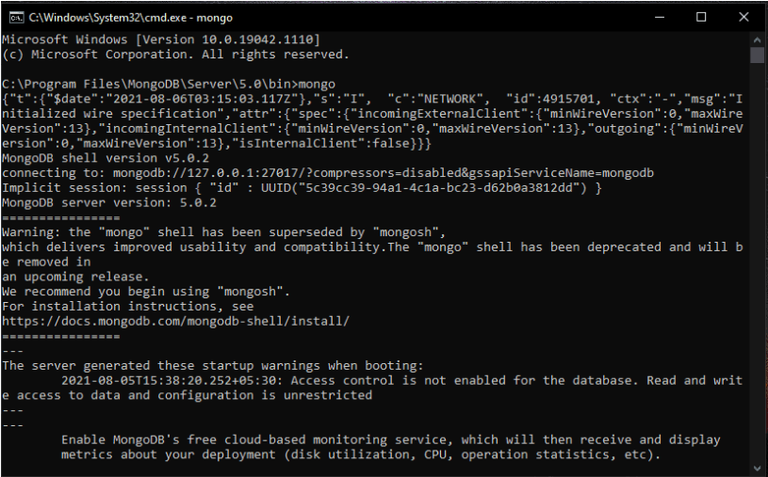
Steps to Import JSON file into MongoDB
Open command prompt, start the MongoDB server.

Slide 23
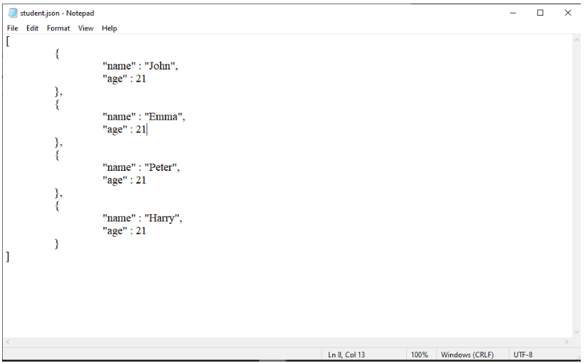
Steps Cont..
This is the JSON(student.json) file that we are going to import into database

Slide 24
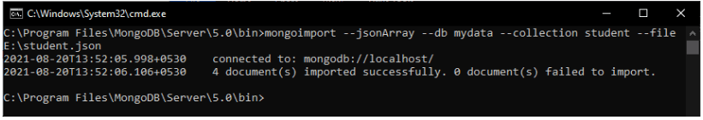
Steps Cont..
Again open command prompt till bin folder and write the following command and execute it.
C:\Program Files\MongoDB\Server\5.0\bin>mongoimport --jsonArray --db mydata --collection student --file F:\students.json
Import JSON file into MongoDB

Slide 25
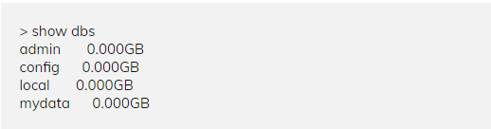
Steps Cont..
Now the student.json file is successfully imported in MongoDB database.
You can check the database in MongoDB with show dbs command this is show you all the databases that you have created into MongoDB database.
Here, the mydata database is successfully created in the MongoDB database.

Slide 26
Interview Questions
What is NOSQL?
What are advantages of NoSQL?
What are the different types of NoSQL databases? Give some example.
Is MongoDB better than other SQL databases? If yes then how?
What is the Column store database?
What is the difference between MongoDB and MySQL?
Why does Profiler use in MongoDB?
Who is known as the father of JSON?

Slide 27
Practice Questions
What is the differences between MongoDB and MYSQL?
How to Creating a database using “use” command?
How to create a Collection/Table using insert() command?
Write a query for Adding documents using insert() command?
How to write Count() & Remove() Functions in MongoDB?
Write a Query documents that belong to a specific customer?
Write Query documents that belong to customers older than 40?

Slide 28
References
https://www.javatpoint.com/sql-server-profiler#:~:text=SQL%20profiler%20is%20a%20GUI,the%20SQL%20Server%202000%20version.
https://stackify.com/what-is-sql-server-profiler/
https://www.w3schools.com/whatis/whatis_json.asp
https://www.codeproject.com/Articles/21371/SQL-Server-Profiler-Step-by-Step
https://www.techopedia.com/definition/1245/structured-query-language-sql
https://www.guru99.com/mongodb-update-document.html
https://www.guru99.com/mongodb-count-remove-function.html

Slide 29
Thank you

